Slide 1
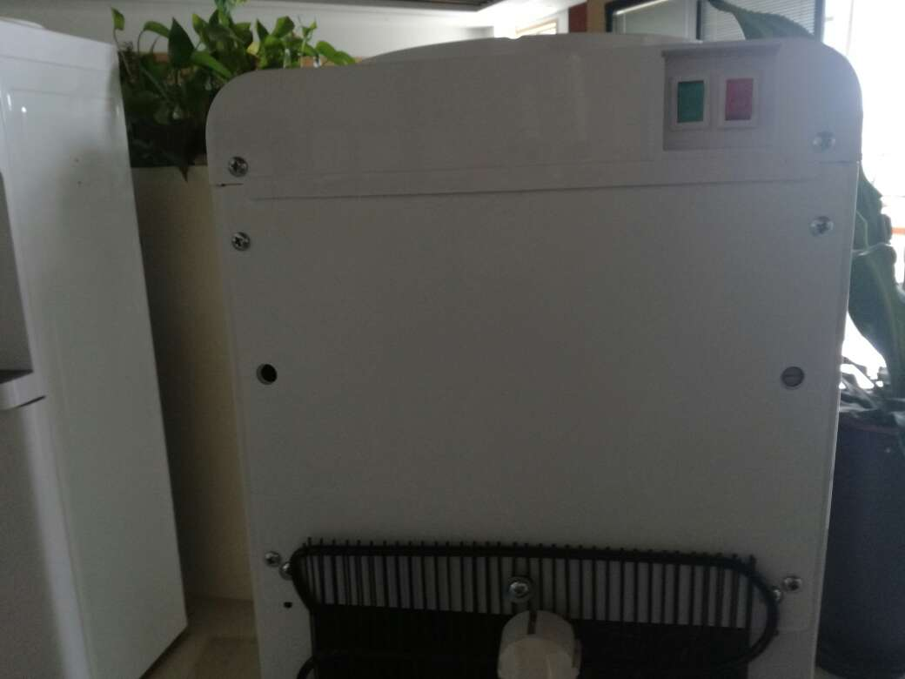
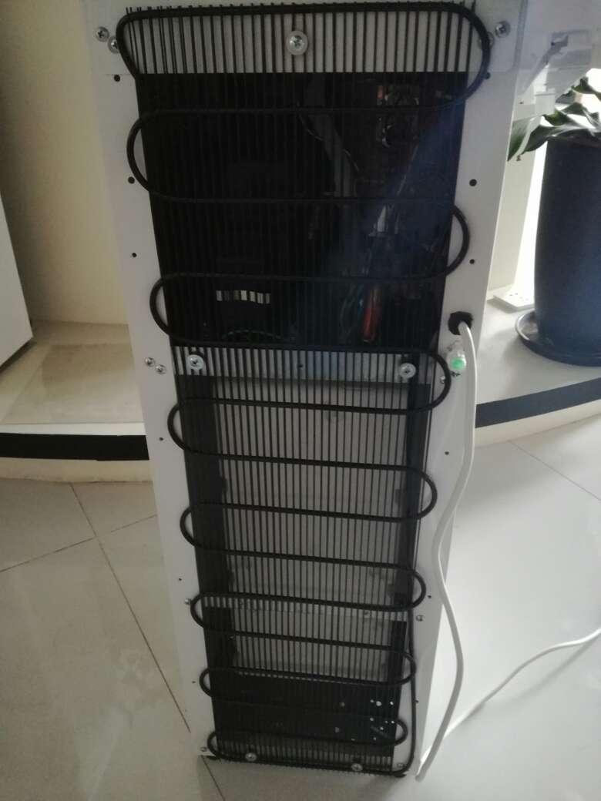
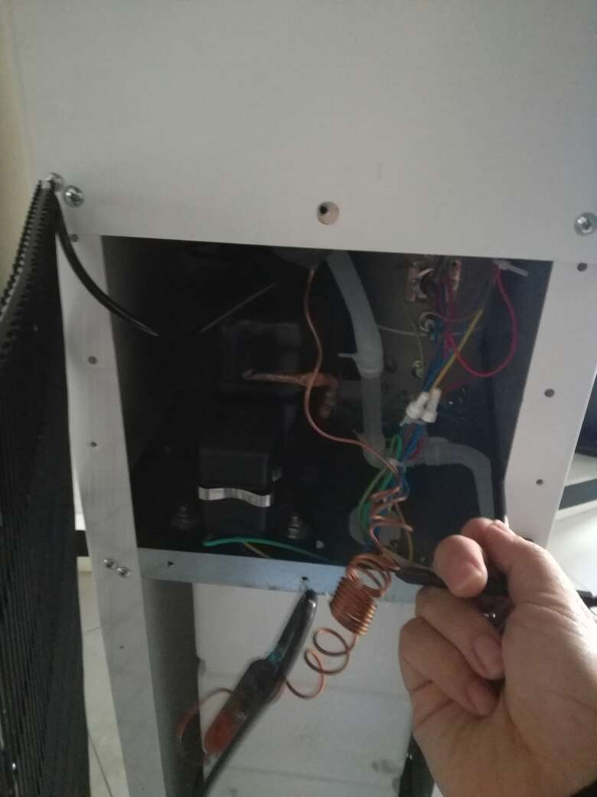
ODYSSEY – Instruction on replacing the faucet
1. Remove the top lid by using a cross screw driver
2. Remove the screw driver with cross driver and remove the screws from the panel below

Slide 2
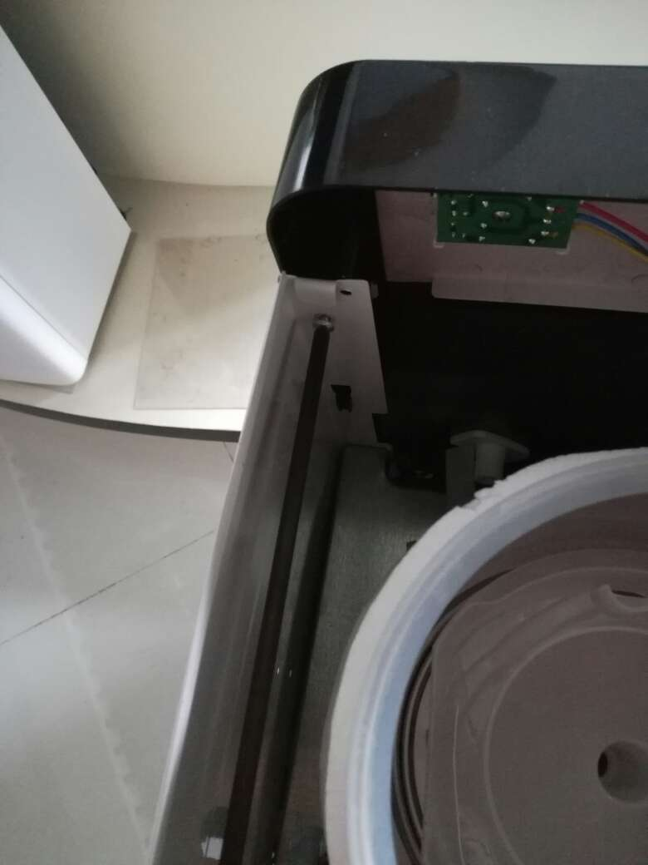
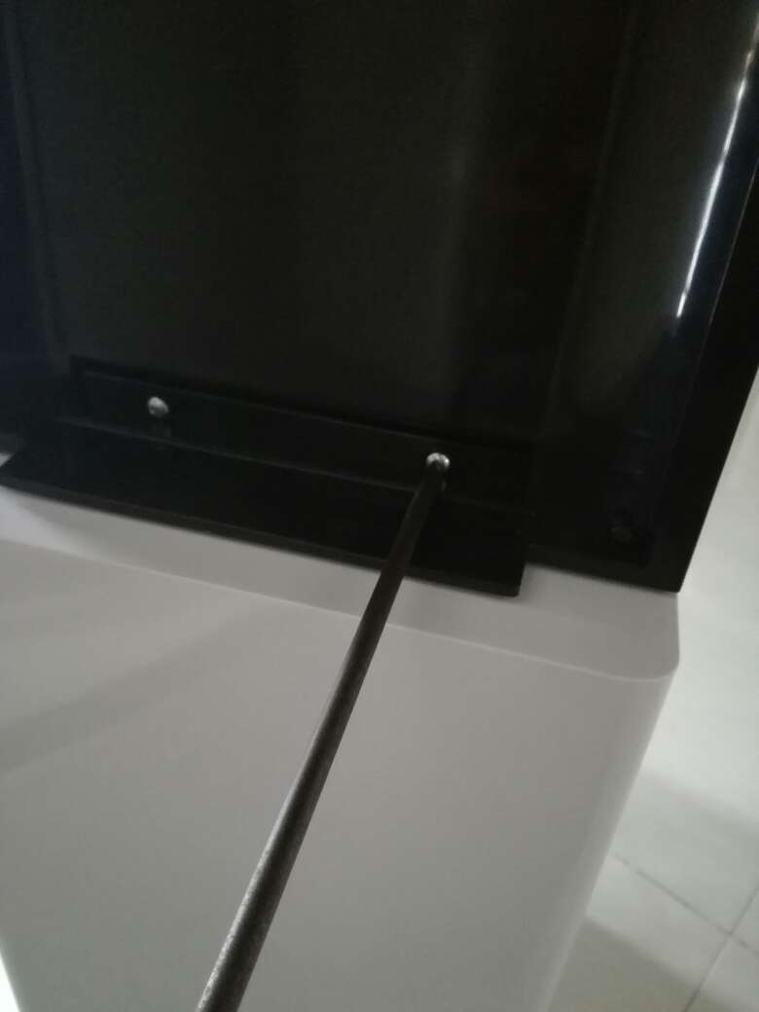
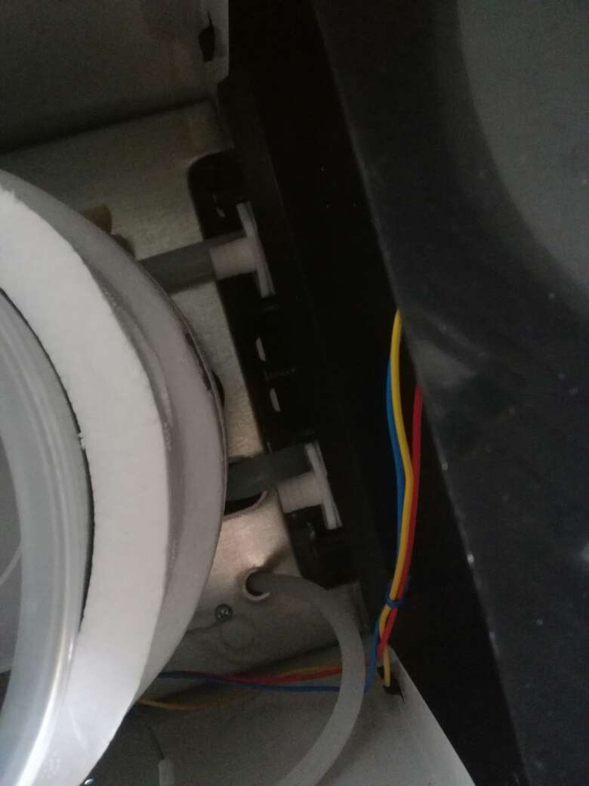
ODYSSEY – Instruction on replacing the faucet
3. Remove the panels below
4.Remove the silicone tubing from the faucet and the front panel

Slide 3
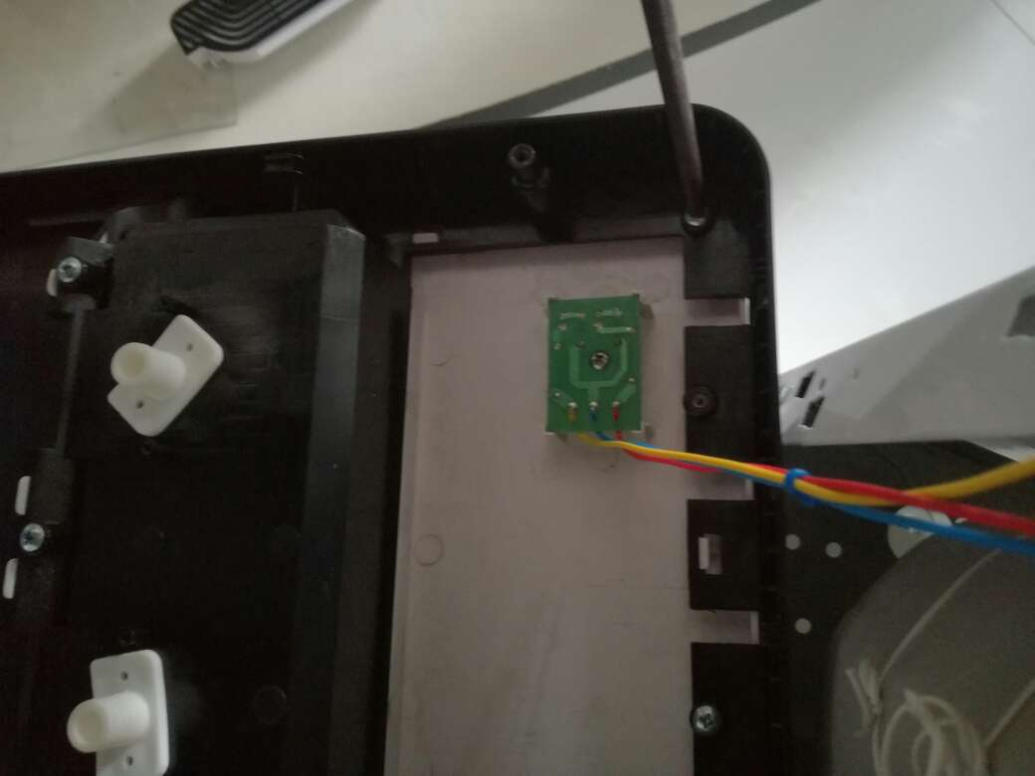
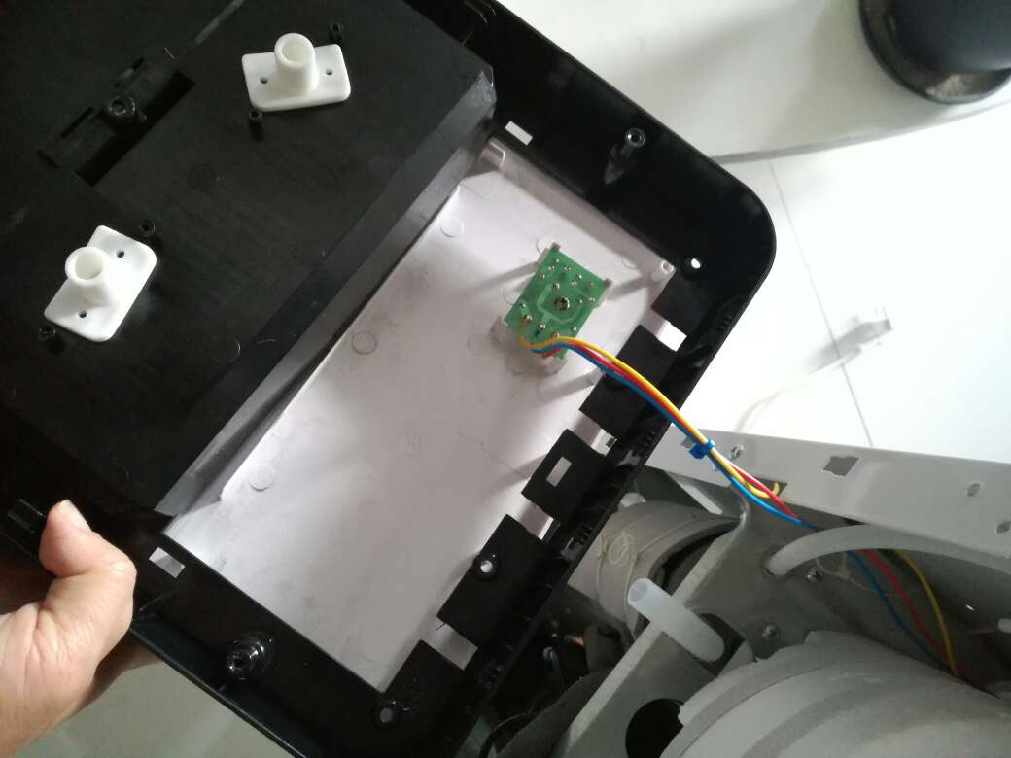
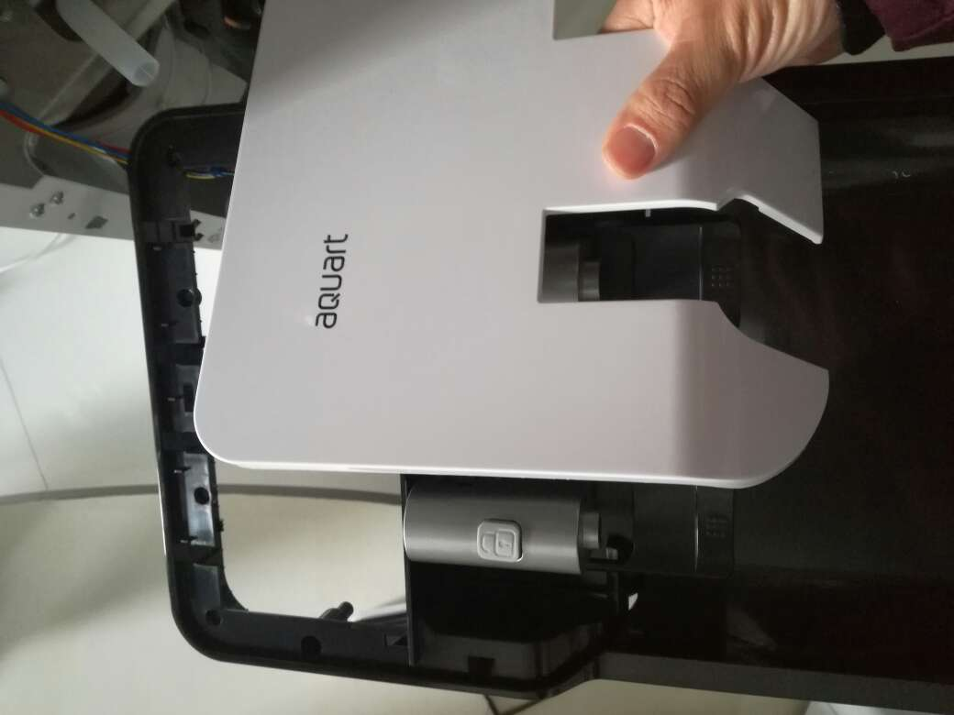
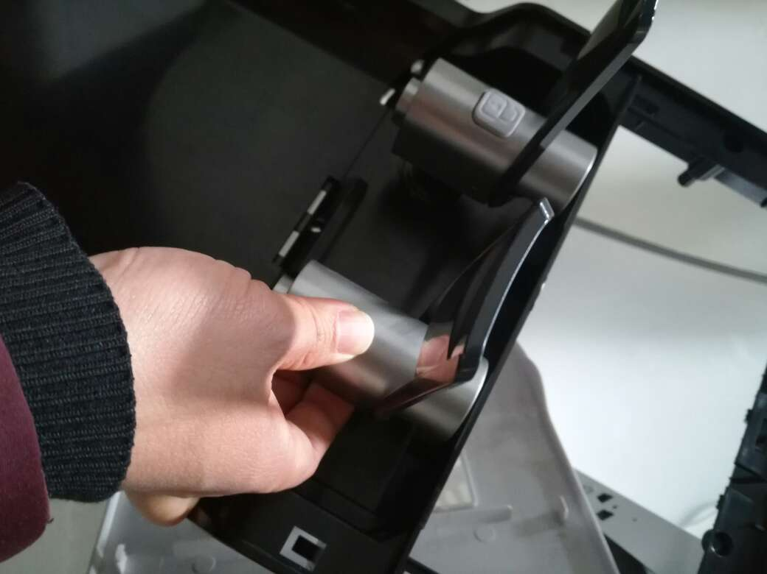
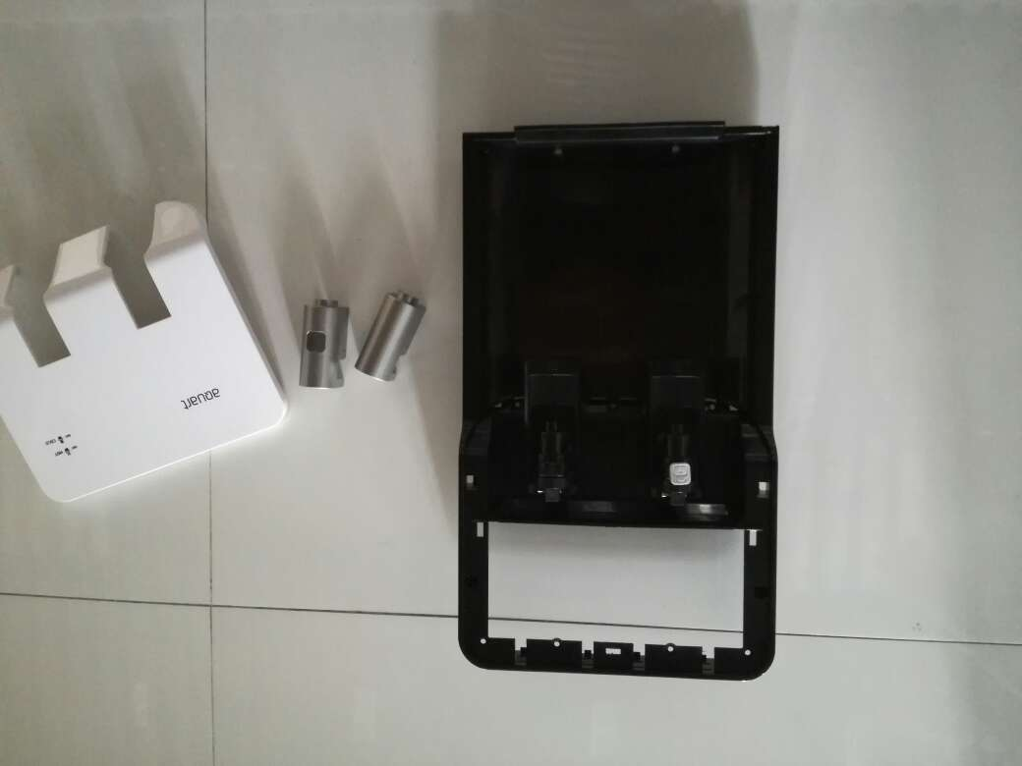
ODYSSEY – Instruction on replacing the faucet
5.Remove below panels
6.Lift the faucet pedal and remove the cover

Slide 4
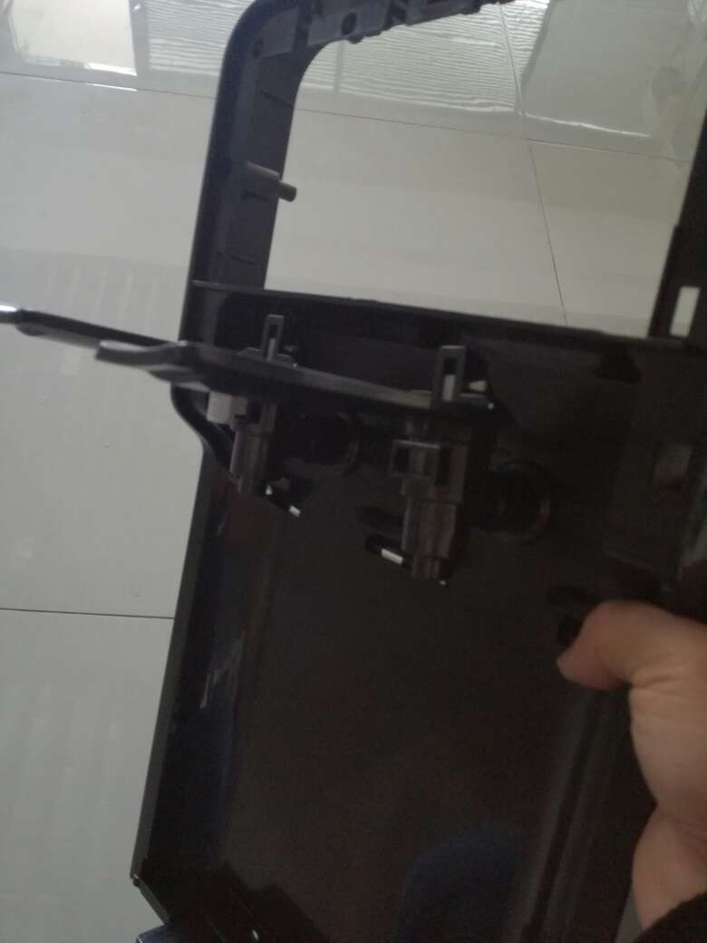
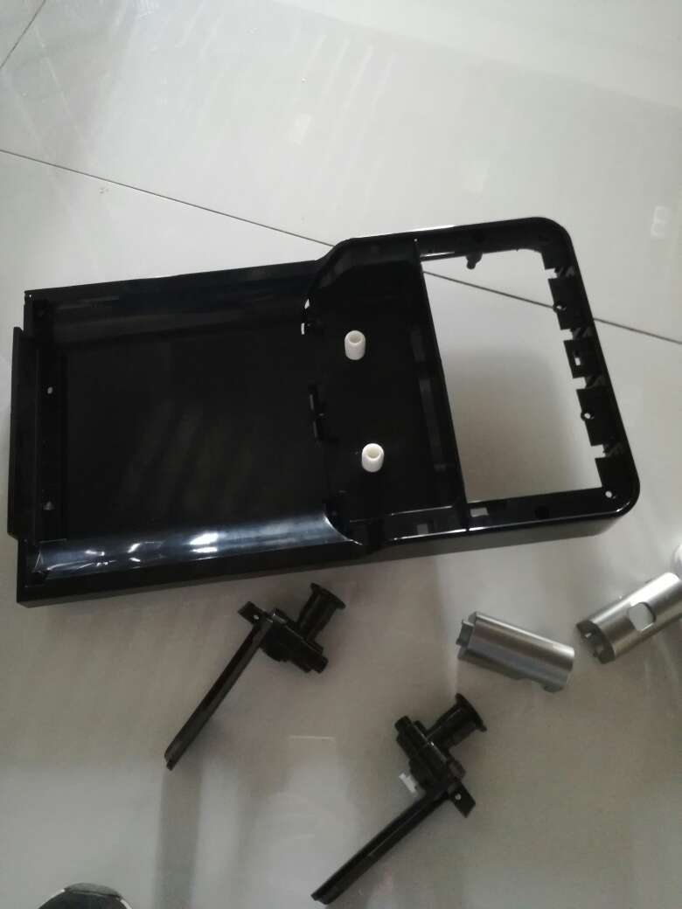
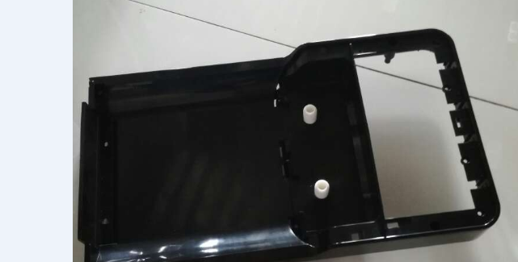
ODYSSEY – Instruction on replacing the faucet
7.Twist the faucet and remove the faucet
The faucet joint needs to be re-wounded with the raw material belt, re-rotate the new faucet, reinstall it in the order of disassembly, and replace the faucet.
need new belt material

